Slide 1

Fake News Detection Using Machine Learning
Presented By: Jaishree Kushwaha
Department: Computer Science
and Engineering

Slide 2

Agenda
Introduction
Problem Statement
Objectives
Dataset
Machine Learning Process
Algorithms
Results
Future Scope

Slide 3

Introduction
Fake news spreads rapidly through social media.
Manual verification is difficult.
Machine Learning can classify news automatically.
NLP helps analyze textual content.

Slide 4

Problem Statement
Increasing misinformation online.
Difficult to verify every article manually.
Need for automated fake news detection.

Slide 5
Objectives
Detect fake news accurately.
Reduce misinformation.
Improve decision making.
Build a reliable ML model.

Slide 6
Dataset
Dataset Files:
• Fake.csv
• True.csv
Features:
• Title
• Text
• Subject
• Date

Slide 7
Data Preprocessing
Remove Null Values
Remove Stop Words
Tokenization
Stemming
Lowercase Conversion

Slide 8
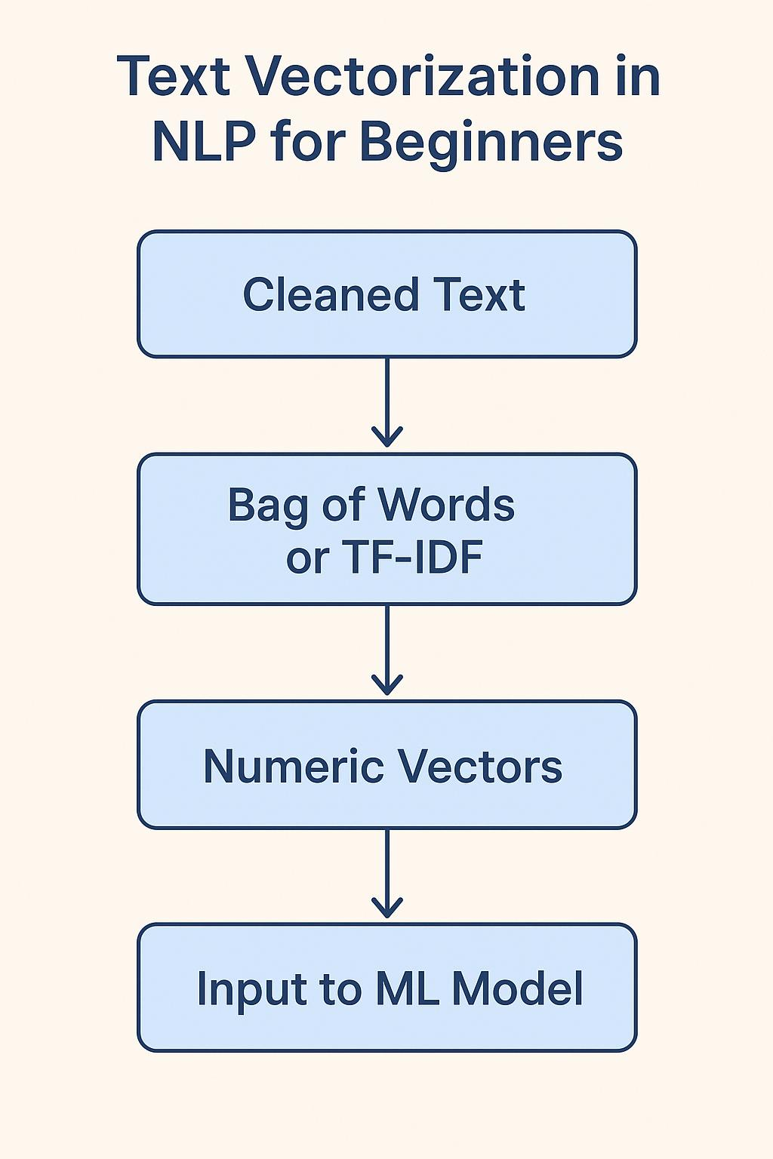
Feature Extraction
TF-IDF Vectorizer
Count Vectorizer
Convert Text into Numerical Features

Slide 9
Machine Learning Algorithms
Logistic Regression
Decision Tree
Random Forest
Gradient Boosting

Slide 10
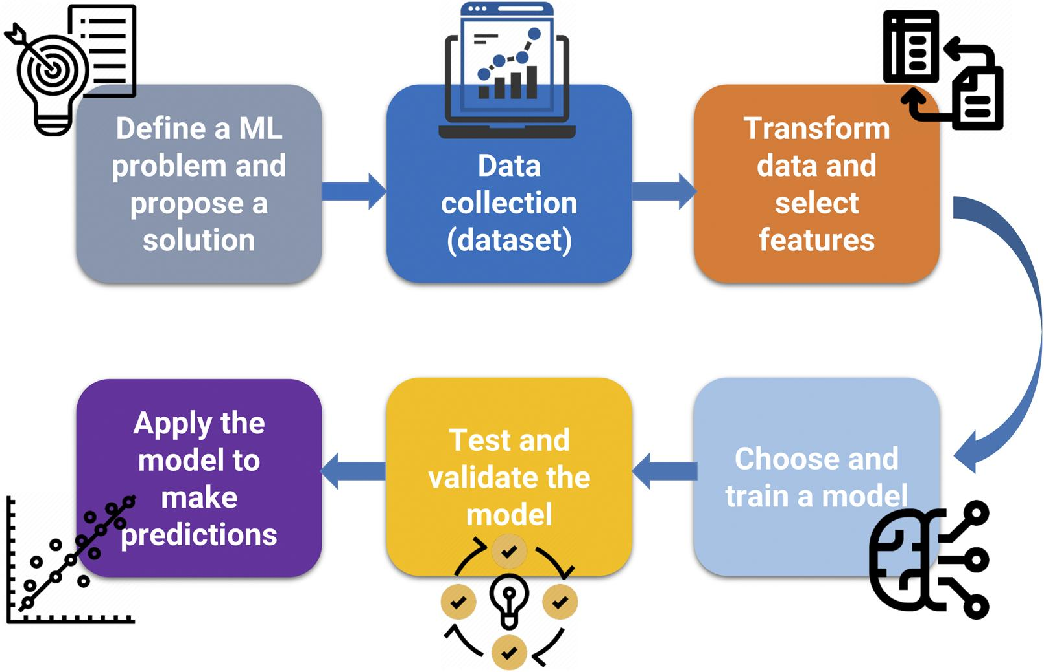

Slide 11
Workflow
Input Dataset
Preprocessing
Feature Extraction
Train ML Model
Prediction

Slide 12
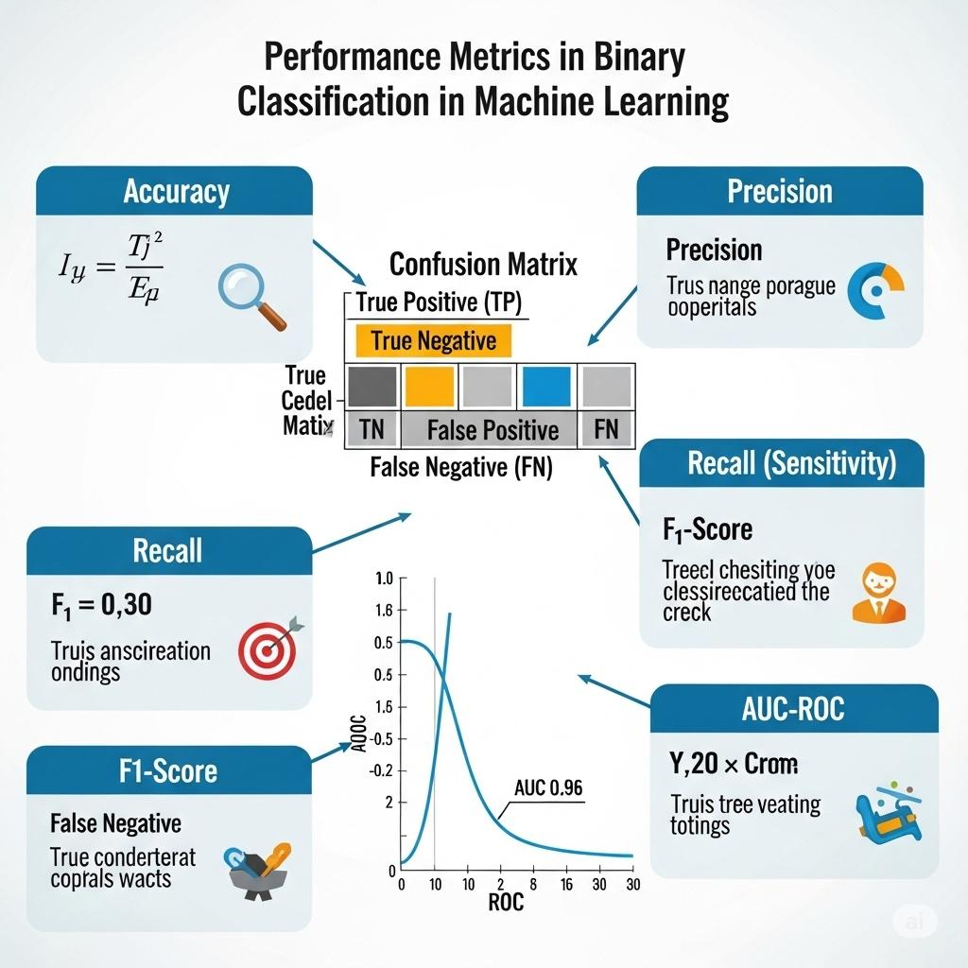
Model Evaluation
Evaluation Metrics:
• Accuracy
• Precision
• Recall
• F1-Score

Slide 13
Results
Example Accuracy:
Logistic Regression - 98%
Decision Tree – 99%
Random Forest - 98%
Gradient Boosting - 99%

Slide 14
Advantages
Fast Prediction
High Accuracy
Reduces Human Effort
Scalable

Slide 15
Limitations
Depends on Dataset Quality
Language Dependency
Sarcasm Detection is Difficult

Slide 16
Future Scope
Deep Learning Models
Real-Time Detection
Multi-language Support
Browser Extension

Slide 17
Thank You
Jaishree Kushwaha

